Slide 1

Book Recommendation System
Michel LeRoy
AVC Mid-Project Review

Slide 2
Highlights
Top accomplishments during this sprint:
Data Wrangling
Downloaded the data, cleaned it, and have 15 separate dataframes, one for each genre, for my book recommendation models
AWS setup
Set up S3 bucket, RDS instance, and EC2 instance

Slide 3
Review Progress
Completed Stories:
Epic 1: Download Data and Create Full dataset for model
(1 point) *** Story 1: Understand how the different tables merge together, and decide what data is necessary for this project
(2 points) *** Story 2: Perform EDA, making sure the data is clean, makes sense, and there are no outliers, etc
(2 points) *** Story 3: Create Final clean dataset that will be used to train the model
Epic 2: Create Recommendation System Model
(4 points) ** Story 1: Create a User-Based Collaborative Filtering Model (this story is half completed)
The other stories I have completed were not originally stories when the backlog was created; I only had rough epics in the IceBox. I have listed these epics below, along with the stories I have completed.
Epic 2: Create the Flask/html/css code to run the user app
Story 1: Create an EC2 instance that the Flask app will run on
Epic 3: Store the final model/ratings matrix in S3
Story 1: Upload raw Kaggle data into S3 bucket
Epic 4: Store the book images in the RDS, and call images of the user’s recommendations from here
Story 1: Create the database schema in RDS for prediction results generated offline ahead of time

Slide 4
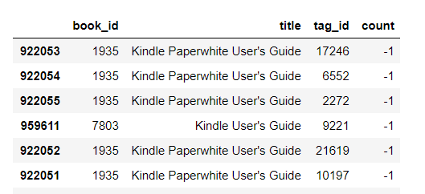
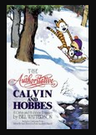
Analysis
The first task accomplished this sprint was data wrangling.
To the right is an example of my data
cleaning; removing books with
negative tags, which obviously do not belong
Next I used the book tags to create the most popular genres and categorize each book. After cleaning, I have 16 data frames of ratings, one for each genre.
Finally, I have run a preliminary SVD model on the “humor” genre of the book ratings data
This model has a 93% precision rate which is above the 80% metric outlined in
my Project Charter Success Criteria.
One of the top books recommended for the humor category is “Calvin and Hobbes”

Slide 5
Lessons Learned
This sprint was much more focused on the coding and software aspects of the project rather than the model itself, which surprised me
I learned how to set up an RDS database, an EC2 instance, as well as an S3 bucket, and the various ways these products interact with one another
I also learned a great deal about configurability and how to create code that another person can run, with packages such as argparse, and config files.

Slide 6
Recommendations
The next sprint should focus primarily on the actual model. The model needs to be finalized, and then the notebooks need to be turned into scripts that have modularized code.
Epic 1: Download Data and Create Full dataset for model
(1 points) * Story 4: Document the code, paying special attention to any decision points
Epic 2: Create Recommendation System Model(4 points) ** Story 1: Create a User-Based Collaborative Filtering Model
(4 points) ** Story 2: Create an Item Based Collaborative Filtering Model
(2 points) ** Story 3: Test how long each model takes to give users new recommendations - Decide which is better in terms of precision and run time
(2 points) * Story 4: Document the code, keeping the final model, and pay special attention to any decision points
(4 points) * Story 5: Create Unit tests
(1 point) * Story 6: Discuss with QA
The secondary priority for this sprint is to get the flask app up and running
Epic 2: Create the Flask/html/css code to run the user app

